Slide 1


Oracle database
Lecture 51

Slide 2

Today’s Agenda
Introduction To Nested Tables
Declaring & Initializing
Adding Elements
Accessing Elements
Example

Slide 3
Nested Tables
Nested tables are single-dimensional, unbounded collections of homogeneous elements.
Following is the description of each term:
Single-dimensional, means that each row has a single column of data like a one-dimension array.
Unbounded means that the number of elements of a nested table is not predetermined.
Homogeneous elements mean that all elements of a nested table have the same data type.

Slide 4
Declaring A Nested Table
Declaring a nested table is a two-step process.
First, declare the nested table type using this syntax:
TYPE <some_name> IS TABLE OF <data type>;
Then, declare the nested table variable based on a nested table type:
<var_name> <nested_table_type>;

Slide 5
Initializing A Nested Table
When we declare a nested table variable, it is initialized to NULL.
To initialize a nested table, we can use a constructor function.
The constructor function has the same name as the type:
<var_name>:= <nested_table_type>();

Slide 6
Initializing A Nested Table
We can also declare a nested table and initialize it in one step using the following syntax:
<var_name> <nested_table_type>:= <nested_table_type>();

Slide 7
Adding Elements To Nested Table
To add an element to a nested table, we first use the EXTEND method:
<var_name> . EXTEND;
Then, use the assignment operator (:=) to add an element to the nested table:
<var_name>(index_no):=<value>;

Slide 8
Accessing Elements
To access an element at a specified index, we use the following syntax:
<var_name>(index);

Slide 9
Iterating Over Nested Table
Nested tables have the FIRST and LAST methods that return the first and last indexes of elements respectively.
Therefore, we can use these methods to iterate over the elements of a nested table using a FOR loop:
FOR var IN <var_name>.FIRST..<var_name>.LAST LOOP
-- access element
END LOOP;

Slide 10
Exercise
WAP to fetch names of first 10 employees from the EMP table , store them in a nested table and then print them.

Slide 11
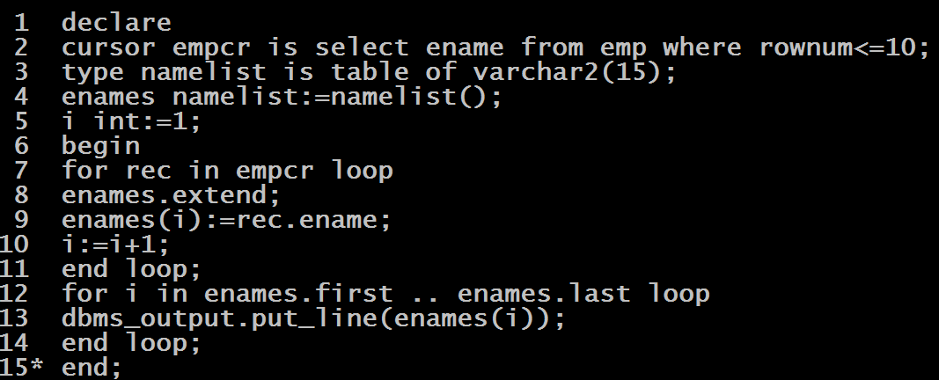
Solution

Slide 12
Associative Array V/s Nested Tables
Associative Array | Nested Tables
Unbounded i.e. the number of elements it can hold is not pre-defined | Unbounded i.e. the number of elements it can hold is not pre-defined
Index can be arbitrary numbers or strings. Need not be sequential. | Indexes are sequential numbers, starting from one
Works as key-value pairs. | Similar to one-column database tables.
Most flexible. Size can increase/ decrease dynamically. | Almost like associative array, except that subscript values are not as flexible.
They can be used in PL/SQL programs only, cannot be stored in the database. | Can be stored in the database using equivalent SQL types, and manipulated through SQL.

